Slide 1




Over
30,000
Fatal car crashes
per year in the US
In 2021, 42,939 people were killed in
motor vehicle crashes in the US
Transportation Safety
7,388 were people walking
By Kimberly Adams
Sources: US Department of Transportation, Accidents and Fatalities Per Year, Airplane Crashes 1908-2009, NHTSA Summary of Motor Vehicle Traffic Crashes, Safety Record of U.S. Air Carriers

Slide 2

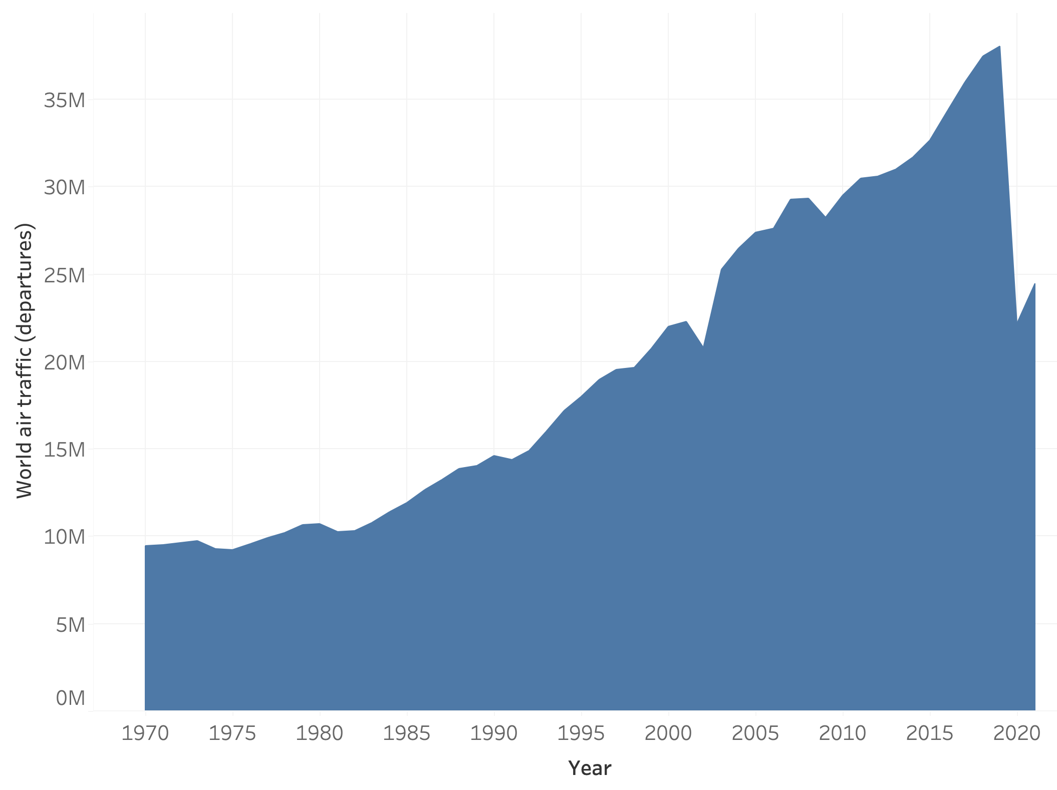

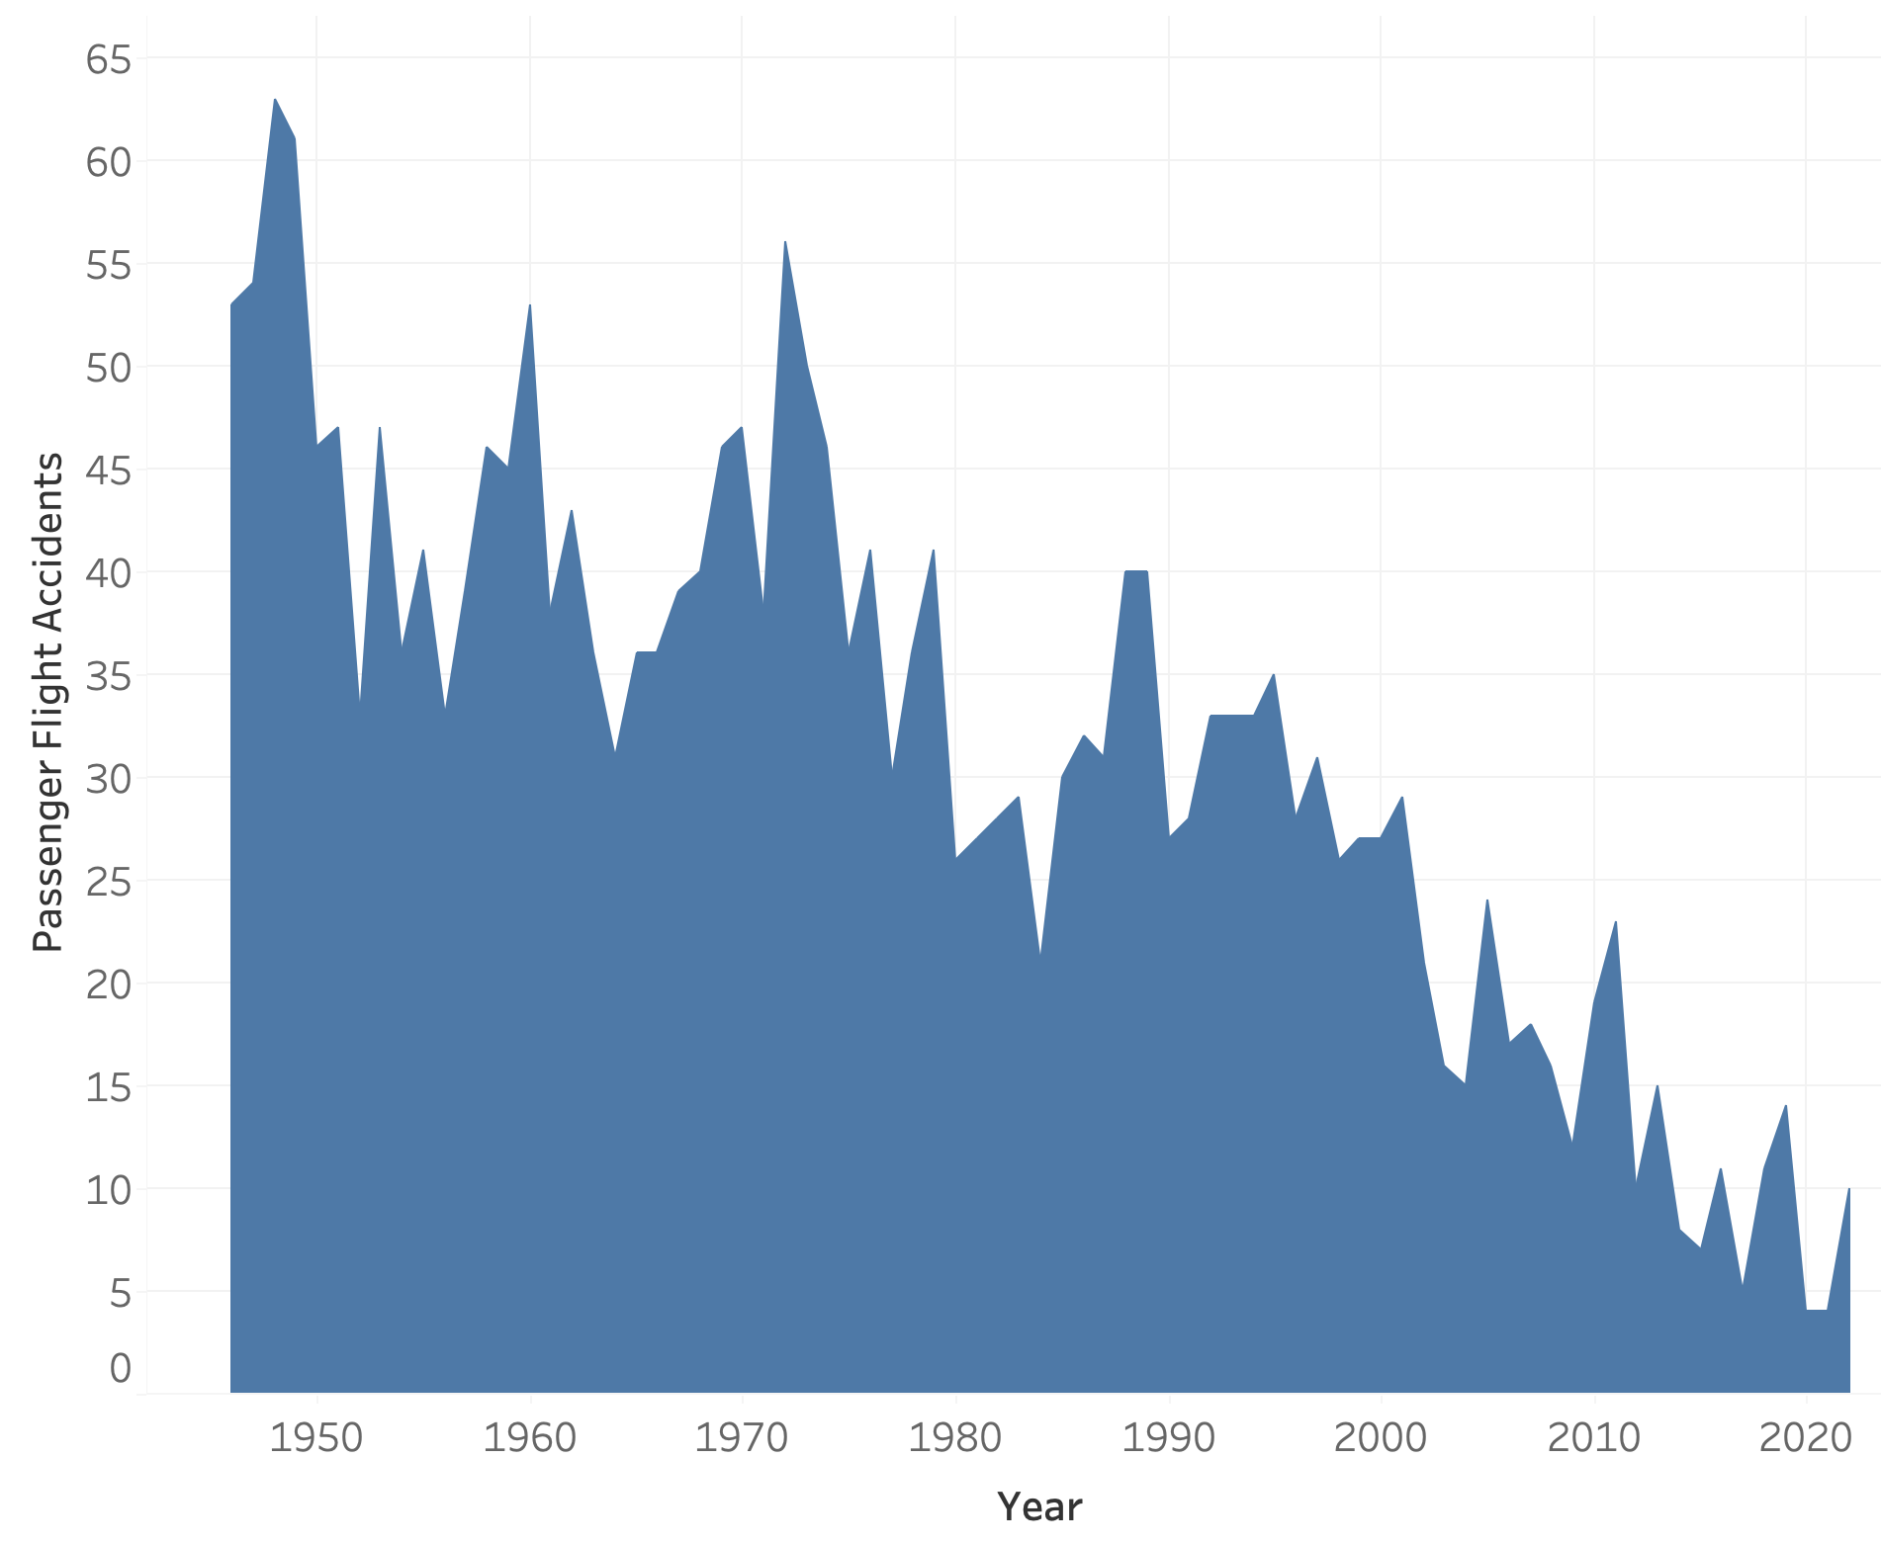
Transportation Safety
From 2011-2020, 370,000 people
died in transportation
incidents in the US
Over
30,000
Fatal car crashes
per year in the US
In 2021, 42,939 people were killed in
motor vehicle crashes in the US
Only 1%
(4,177) of deaths were due to air travel
7,388 were people walking
More than
40 Million
flights takeoff per year
around the world
Yearly passenger flights
increased 400%
since the 1970’s
Roughly
40M
to
10M
Yearly airline accidents
decreased 83%
since the 1950’s
Roughly
65
to
10
1 in 2,222,998
flights experience an accident
1 in 93 cars crash fatally yearly
Sources: US Department of Transportation, Accidents and Fatalities Per Year, Airplane Crashes 1908-2009, NHTSA Summary of Motor Vehicle Traffic Crashes, Safety Record of U.S. Air Carriers

Slide 3




Transportation Safety
From 2011-2020, 370,000 people
died in transportation
incidents in the US
Over
30,000
Fatal car crashes
per year in the US
In 2021, 42,939 people were killed in
motor vehicle crashes in the US
Only 1%
(4,177) of deaths were due to air travel
7,388 were people walking
More than
40 Million
flights takeoff per year
around the world
Yearly passenger flights
increased 400%
since the 1970’s
Roughly
40M
to
10M
Yearly airline accidents
decreased 83%
since the 1950’s
Roughly
65
to
10
1 in 2,222,998
flights experience an accident
1 in 93 cars crash fatally yearly
Sources: US Department of Transportation, Accidents and Fatalities Per Year, Airplane Crashes 1908-2009, NHTSA Summary of Motor Vehicle Traffic Crashes, Safety Record of U.S. Air Carriers

